Slide 1
Psalms of Hope
in troubled times

Slide 2
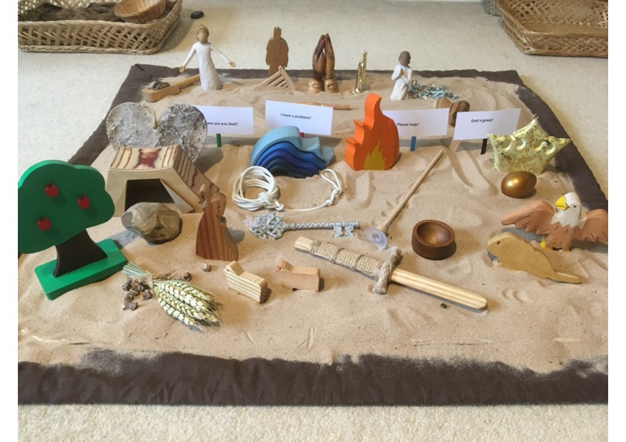
Notes:
KS1 Story of the Psalms final scene

Slide 3
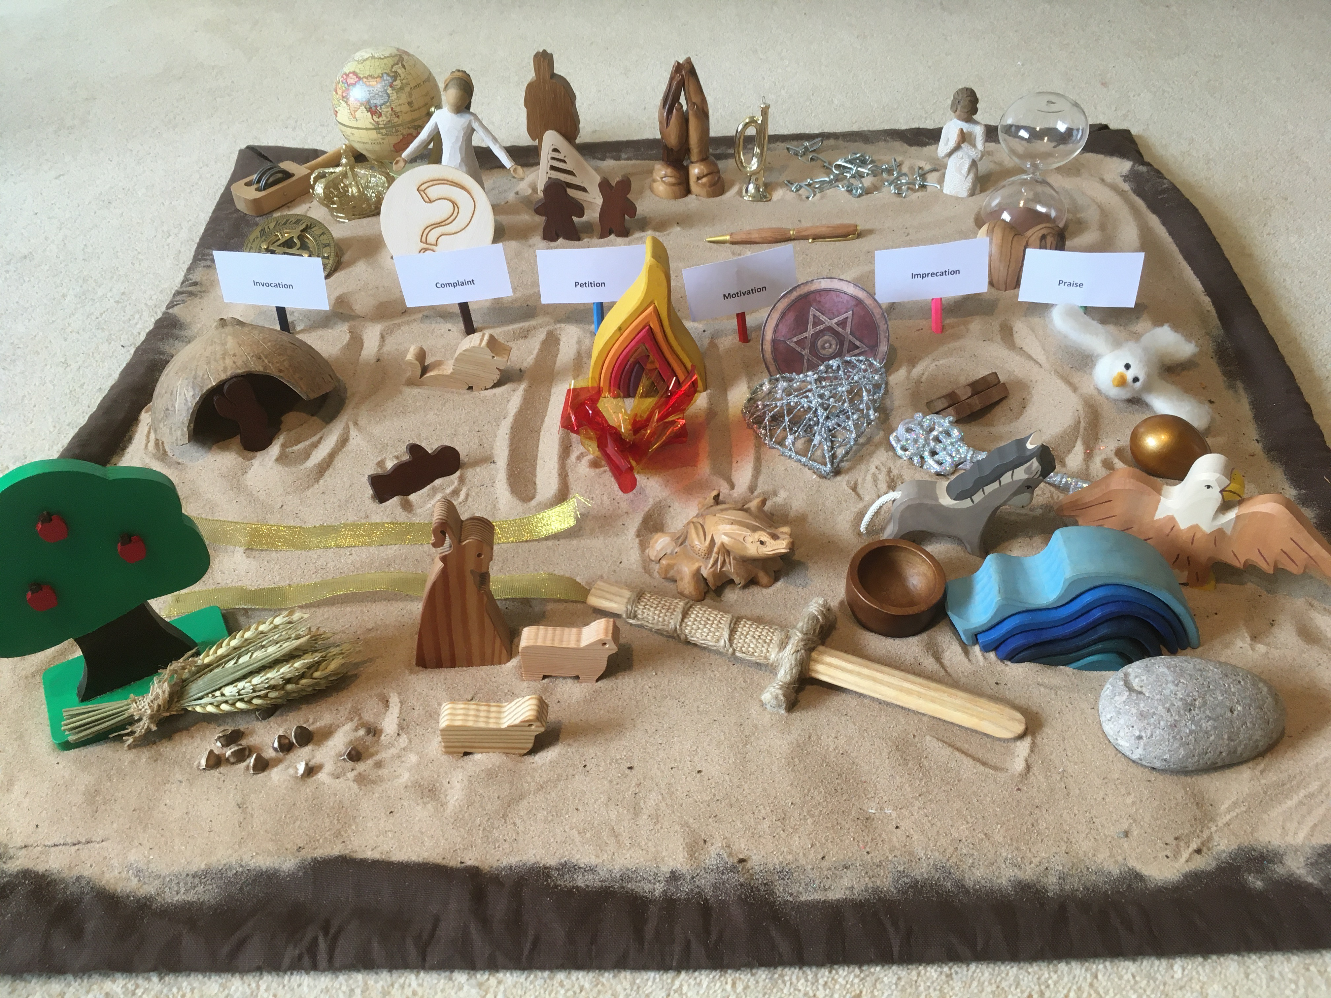
Notes:
KS2 Story of the Psalms final scene

