Slide 1
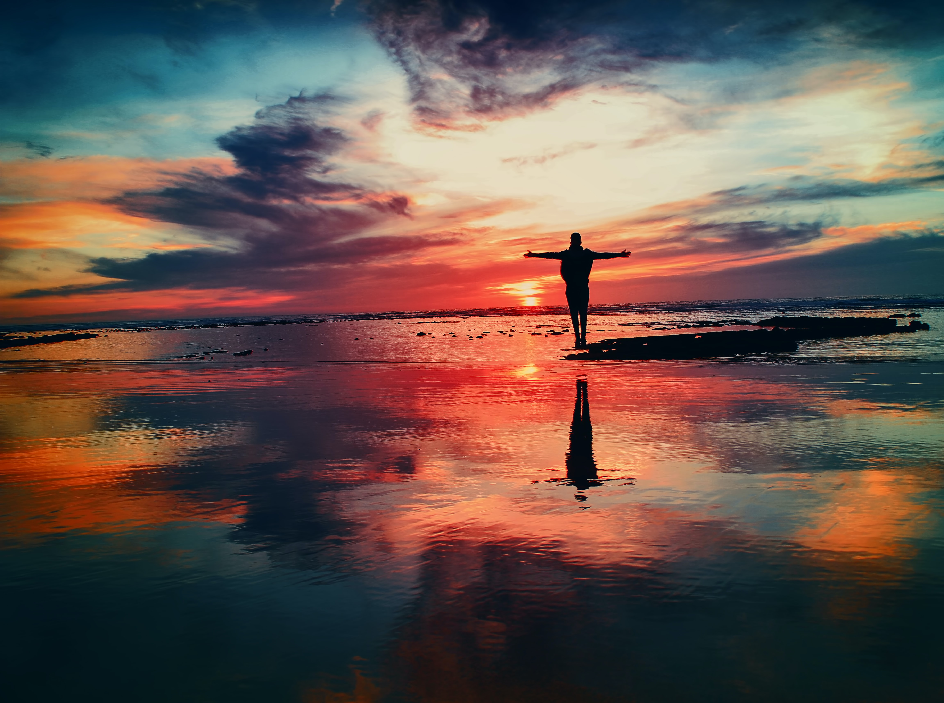
Psalms of Hope
in troubled times

Slide 2
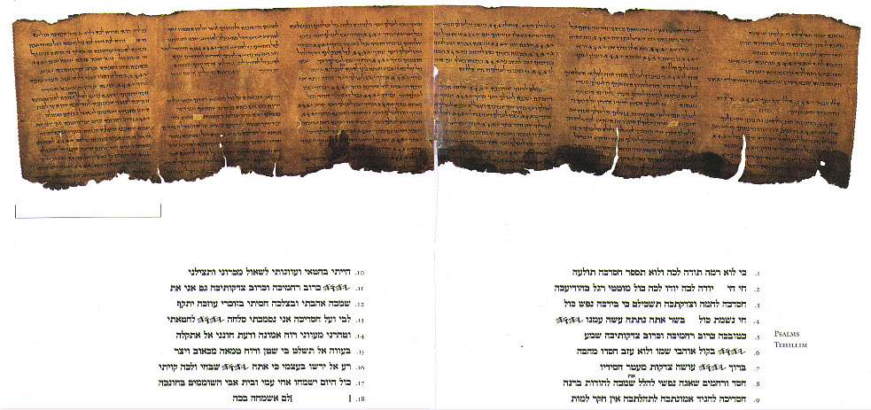
Notes:
But first, this is the Great Psalms Scroll - the oldest surviving copy of the psalms. It is written in Hebrew on animal skins; and stored rolled up as a scroll.
The Jewish people didn’t paint pictures of God, or even anything God has created. The beautiful handwriting, the calligraphy, is enough to show it is holy scripture.

Slide 3
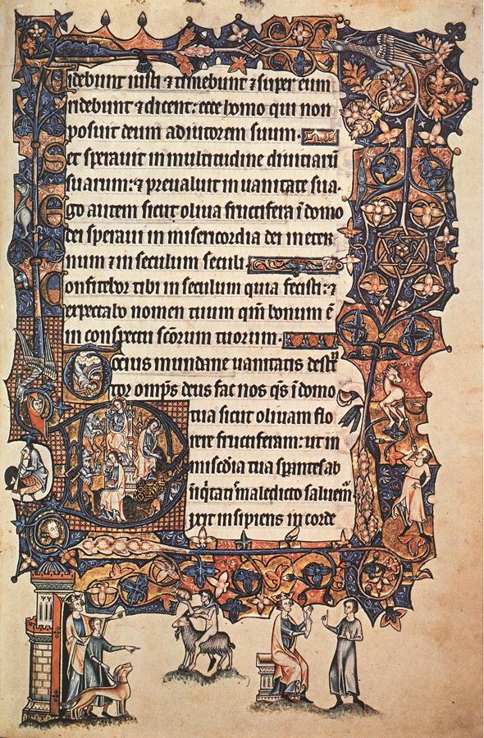
Notes:
Christians liked to add decorations. By the Middle Ages, they were getting more and more elaborate. Some of the monasteries in our area made amazingly decorated, or ‘illuminated’ copies of the Book of Psalms – the psalter. They wrote in Latin on animal skins and bound the pages together to make books, and some of them have survived until today.
This is page from the Ormesby Psalter, which was made in Norfolk at the end of the thirteenth century. The writing has been framed by decorations and pictures. Can you see the donkey and the dog at the bottom?

Slide 4
Notes:
This is a close-up of the page we have just seen. Can you see the angels flying down left the side?

Slide 5
Notes:
Here is another page from the Ormesby Psalter- with a knight in shining armour, and a man creeping up on him.

Slide 6
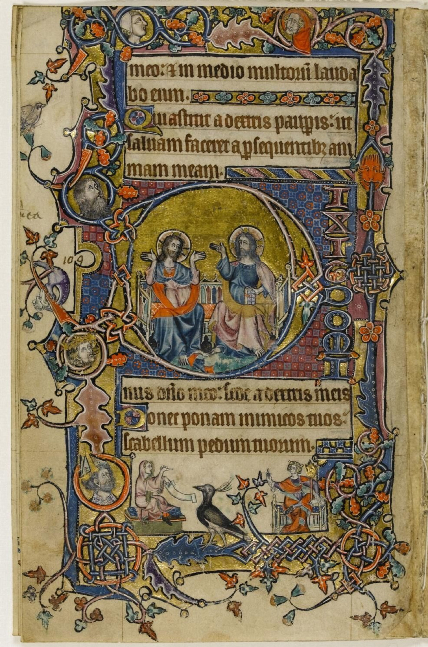
Notes:
This is a page from the Macclesfield Psalter, which was made in East Anglia at the beginning of the fourteenth century. It is now kept in the Fitzwilliam Museum, in Cambridge and sometimes they have it on show so you can go to see it.

Slide 7
Notes:
This is a close-up of the page you have just seen. The middle of the capital letter ‘O’ at the beginning of the psalm has got a picture inside.

Slide 8
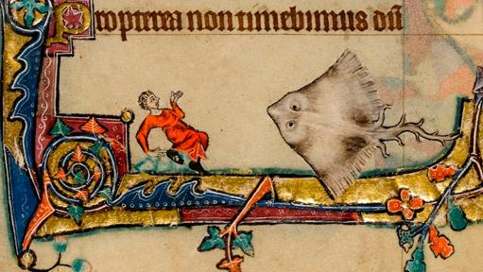
Notes:
Here is another page which has a bit of a joke on – a man is being chased by a huge fish. Can you see the gold leaf?

Slide 9
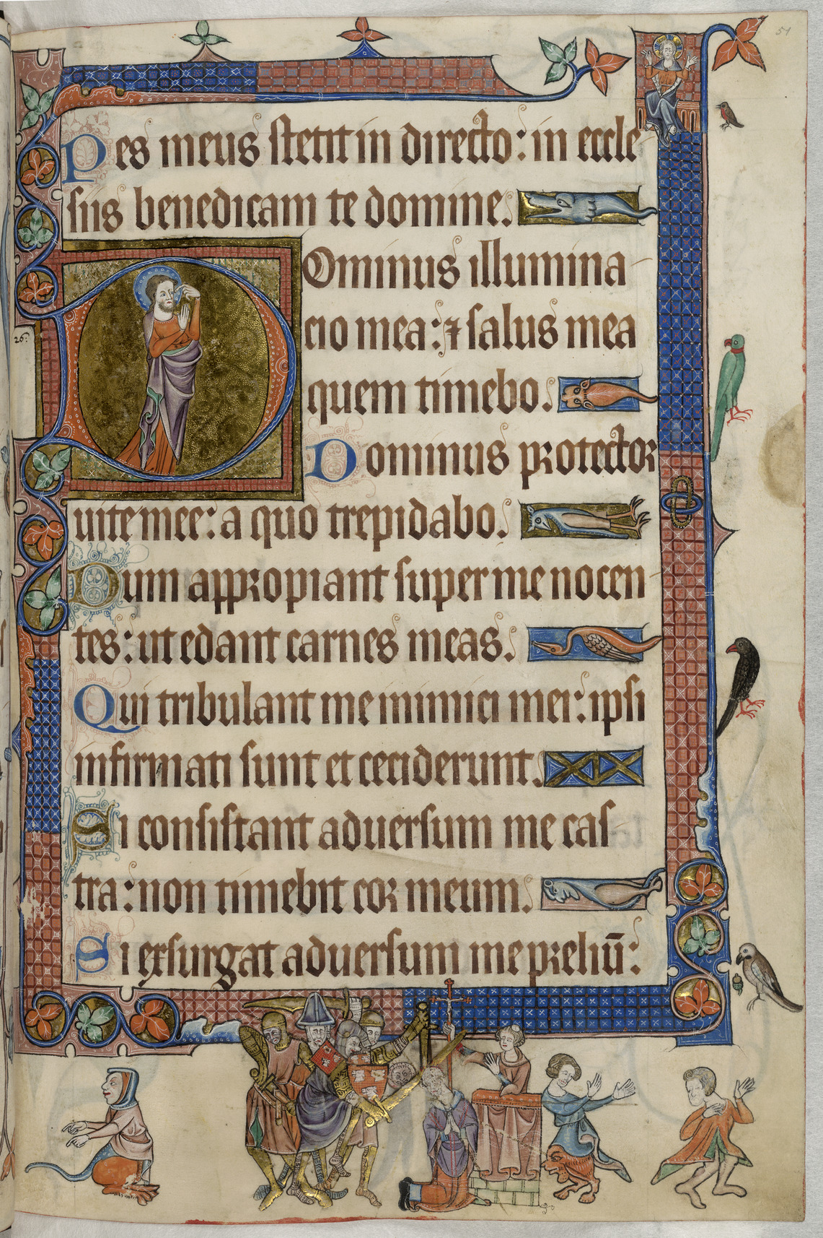
Notes:
This is a page from the Luttrell Psalter, which was made in Bury St Edmund’s in the middle of the fourteenth century. It is part of Psalm 26.

Slide 10
Notes:
Here is a detail of the page you have just seen. Can you see all the little birds down the side?

Slide 11
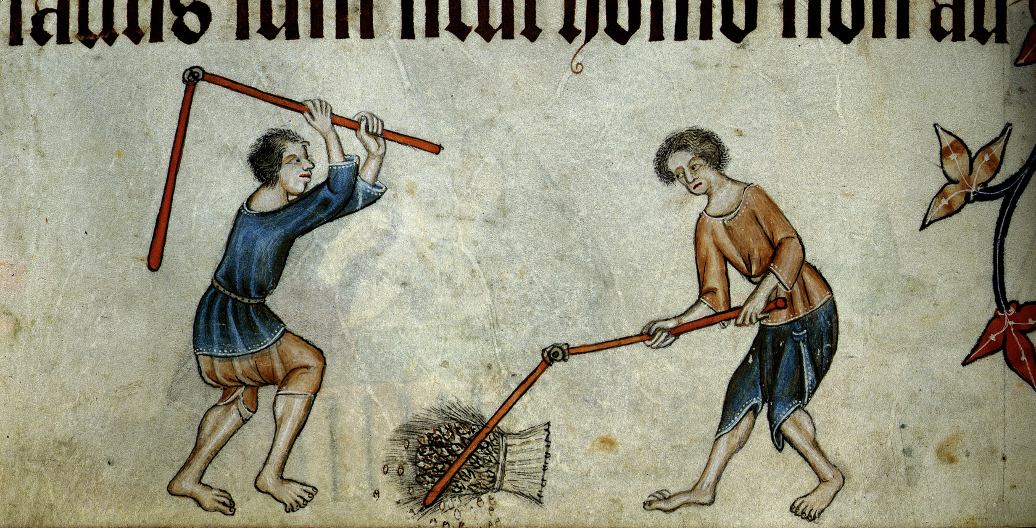
Notes:
This is another page from the Luttrell Psalter. The artist used scenes from everyday life – here they are threshing the corn.

Slide 12
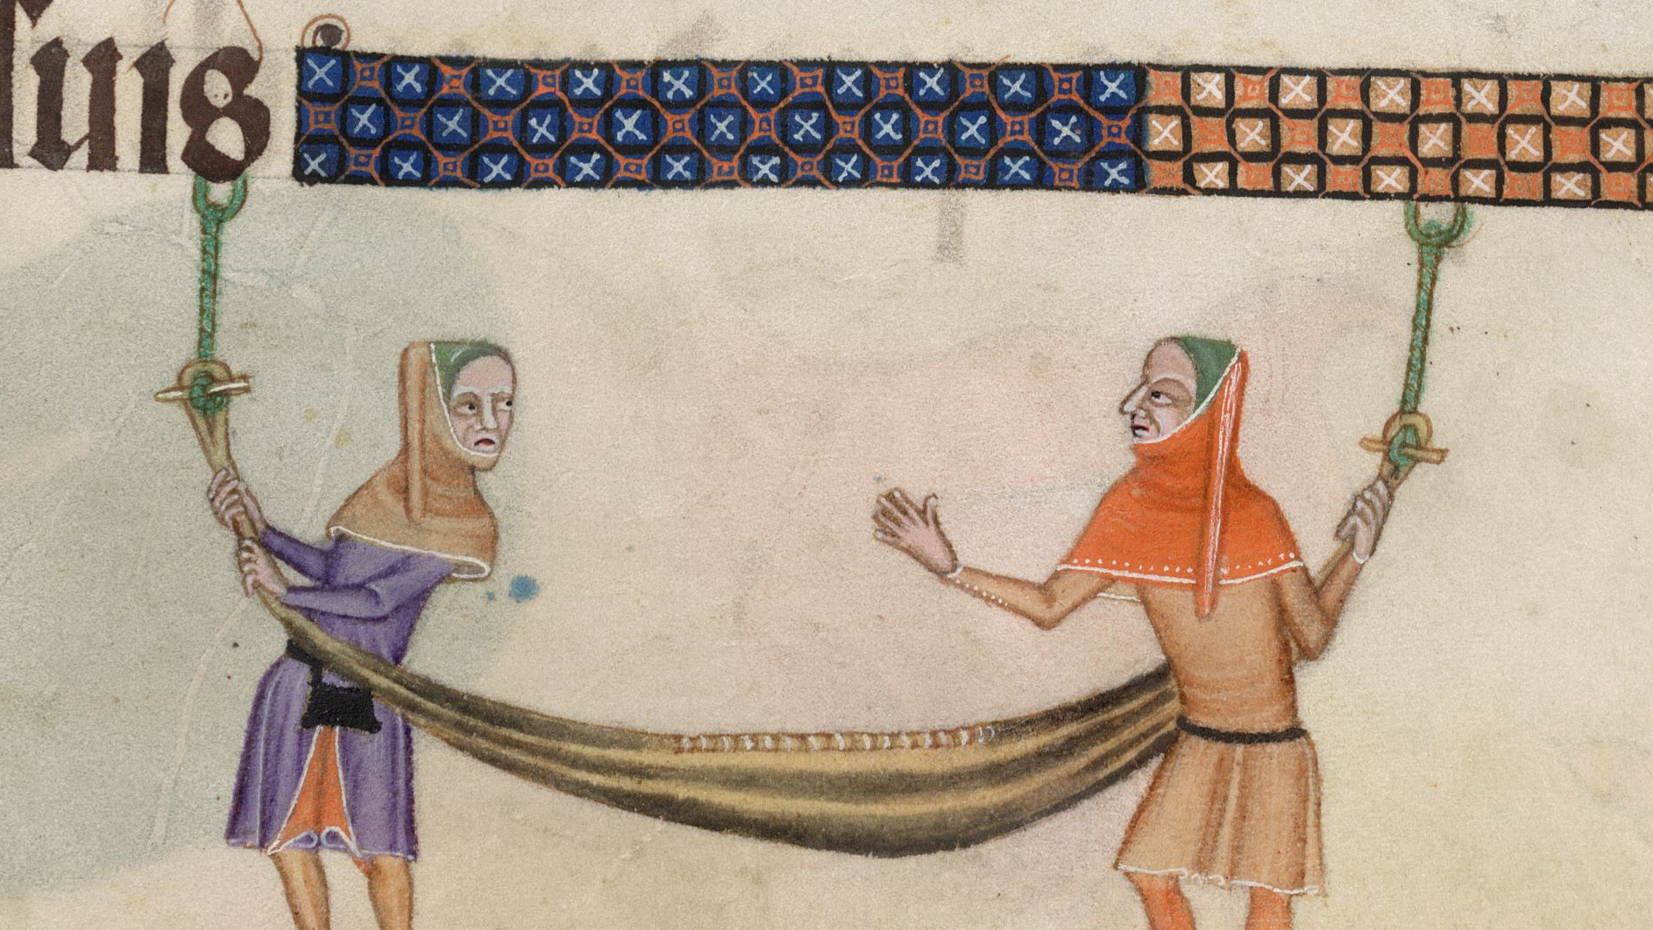
Notes:
Here are two people playing with a hammock.

Slide 13
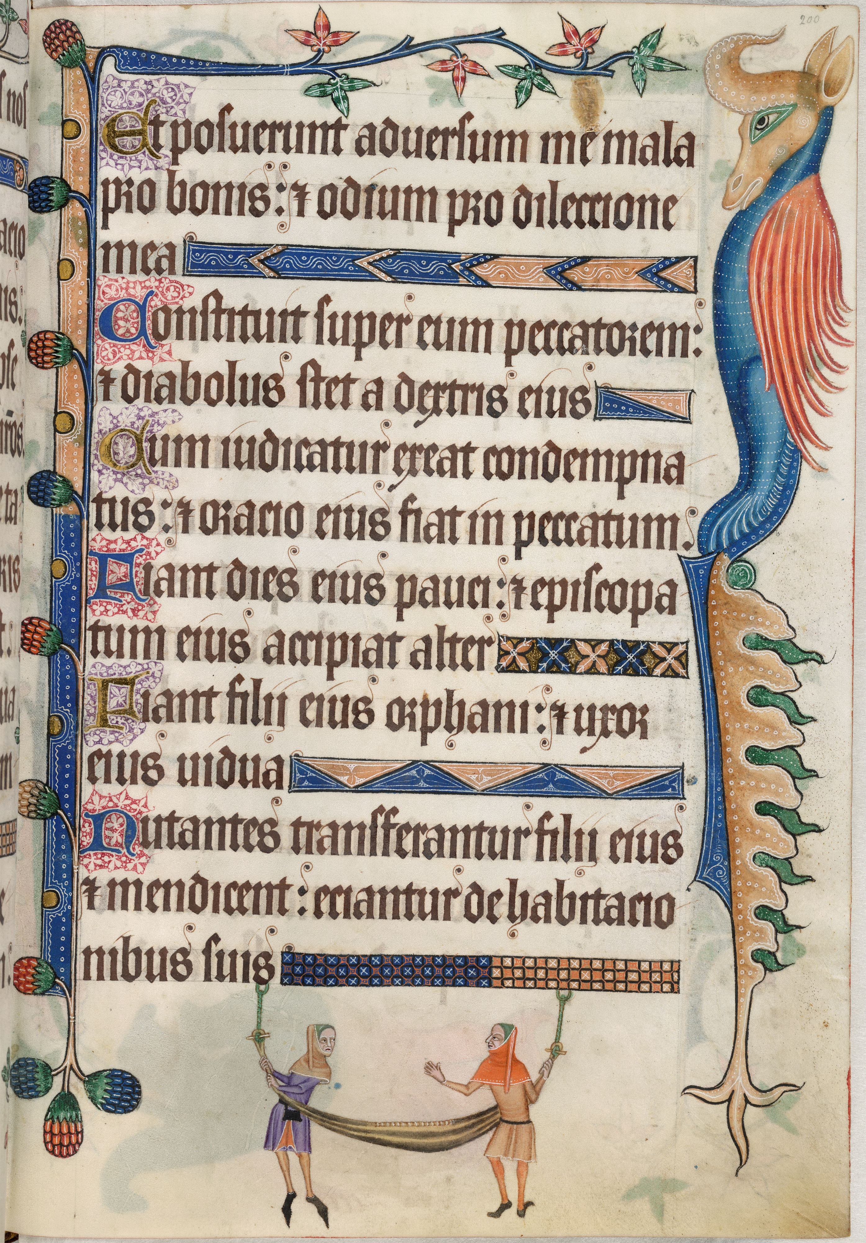
Notes:
Here is the whole page. Can you see the fantastic beast down the side?

Slide 14
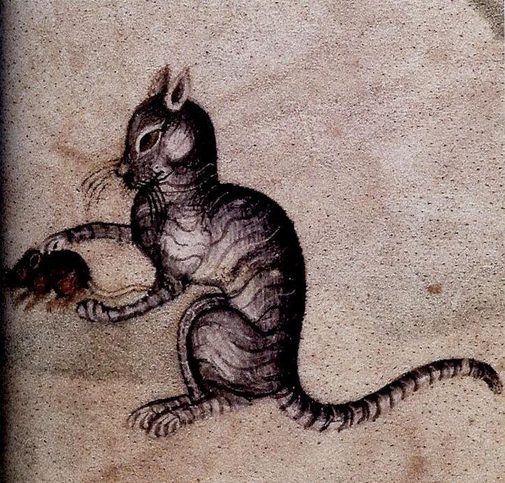
Notes:
This cat has just caught a mouse!

Slide 15
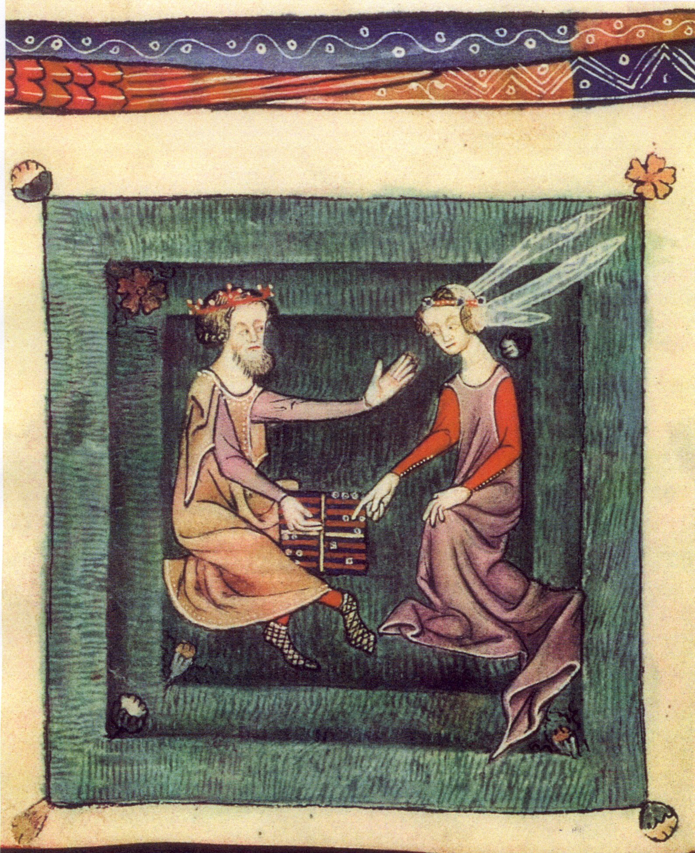
Notes:
Here are two people playing a board game.

Slide 16
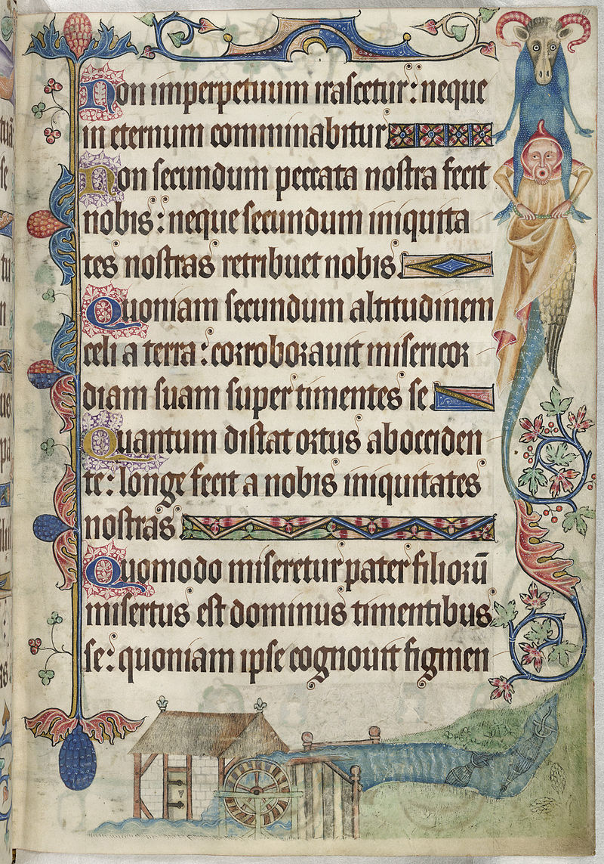
Notes:
Can you see the watermill at the bottom of this page?

Slide 17
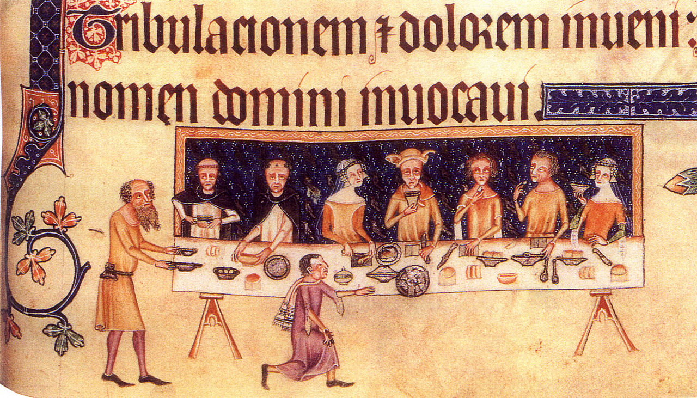
Notes:
The Luttrell Psalter was made for Sir Geoffrey Luttrell.
Sometimes artists added in portraits of the people they were making the book for - can you see Sir Geoffrey in the middle of the table? He is wearing the posh hat.
You might like to put a self-portrait somewhere in your psalm.

Slide 18
Images used are not subject to copyright restrictions
Images in slides 2-17 are freely available on Wikimedia Commons
https://commons.wikimedia.org

