Slide 1
Psalms of Hope
in troubled times

Slide 2
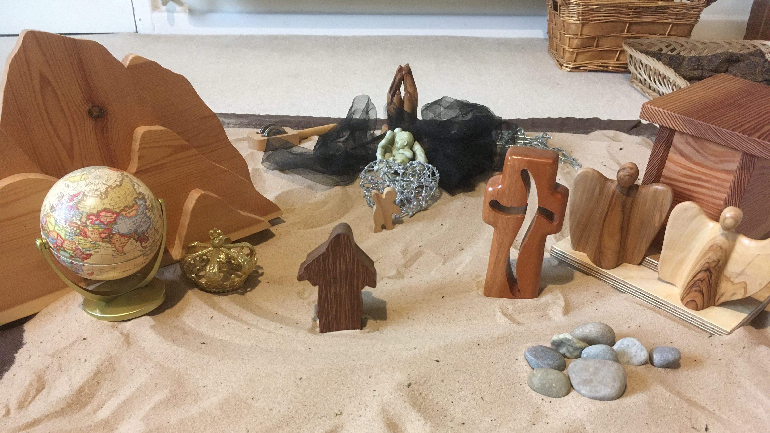
Notes:
Story 1 – hope of being comforted

Slide 3
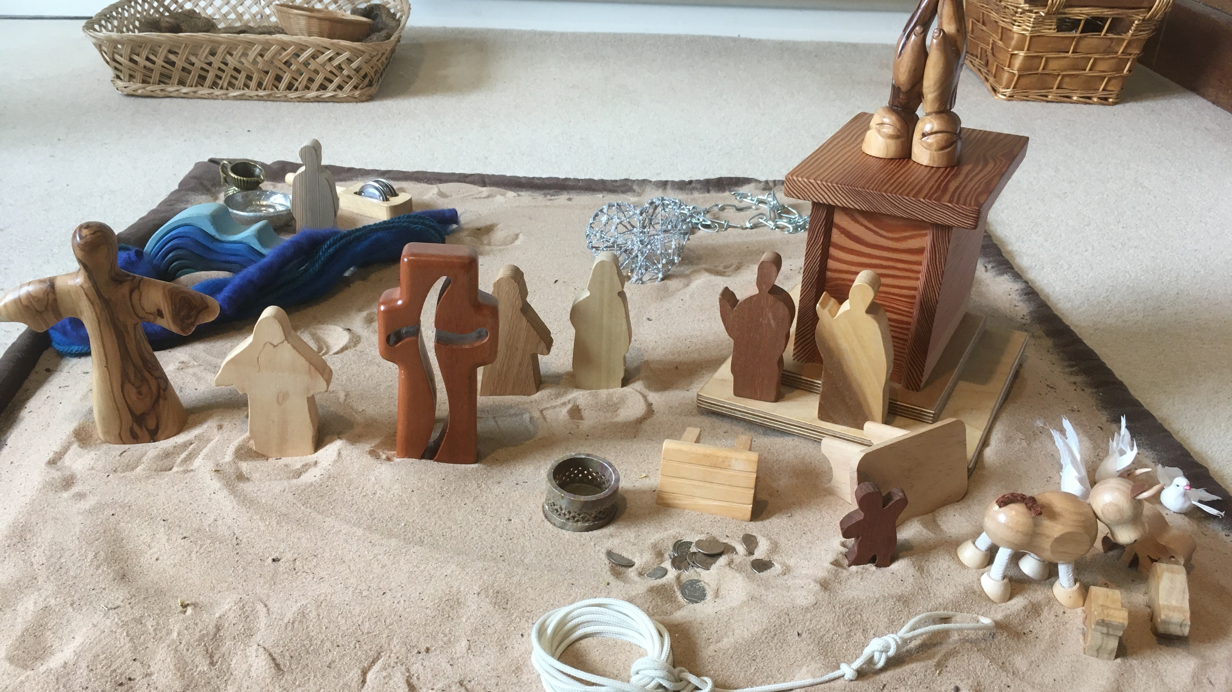
Notes:
Story 2 – ope of help and renewal

Slide 4
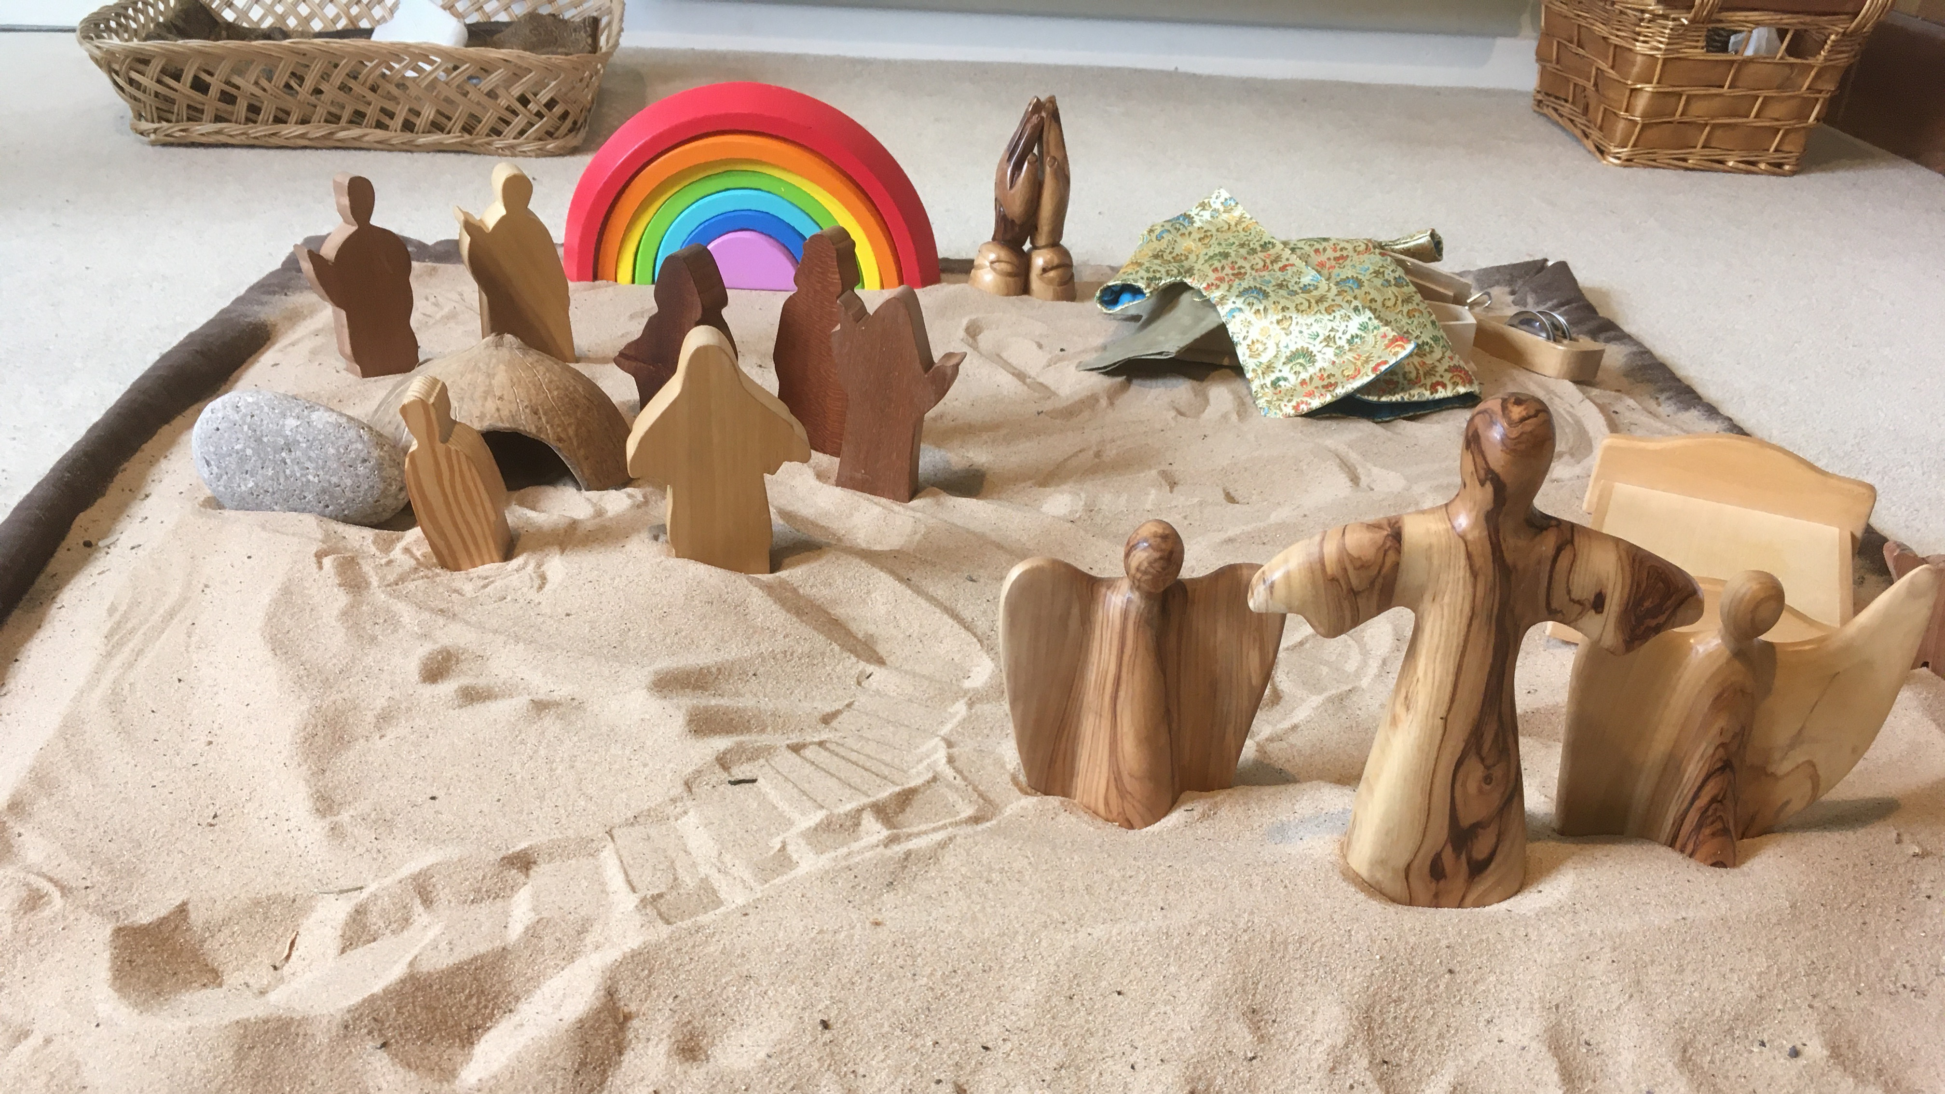
Notes:
Story 3 – hope of new life

Slide 5
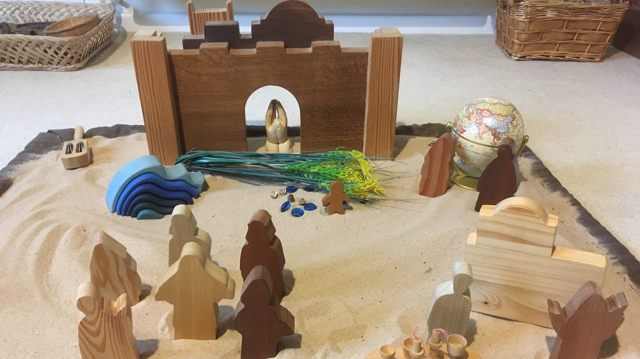
Notes:
Story 4 – hope of being able to offer comfort

Slide 6
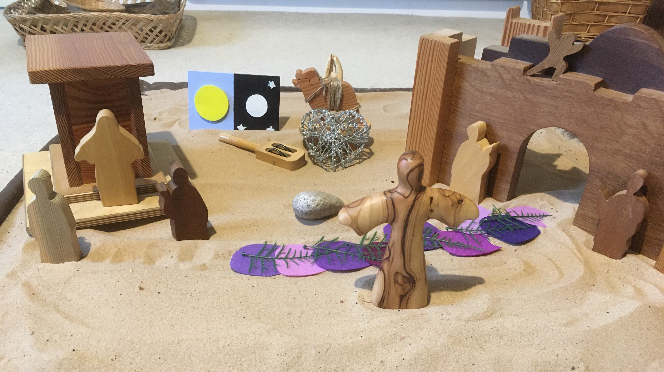
Notes:
Story 5 - hope of happier times

